Slide 1
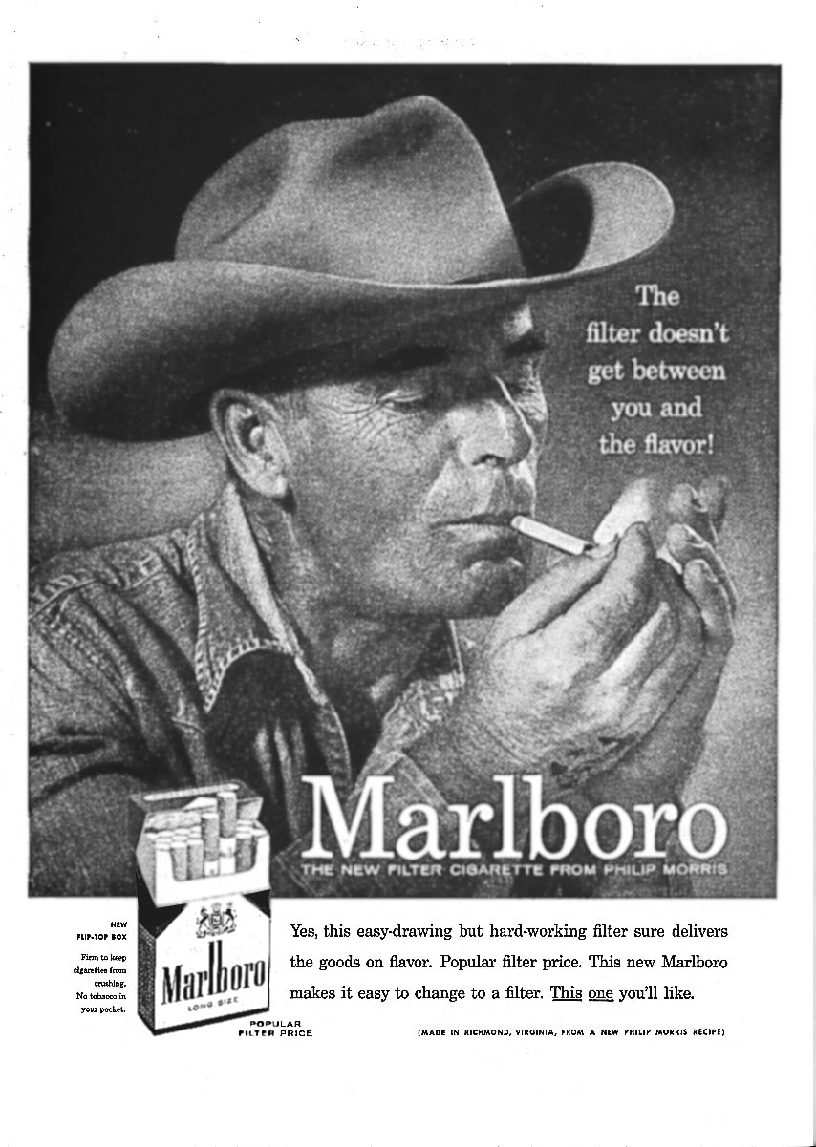
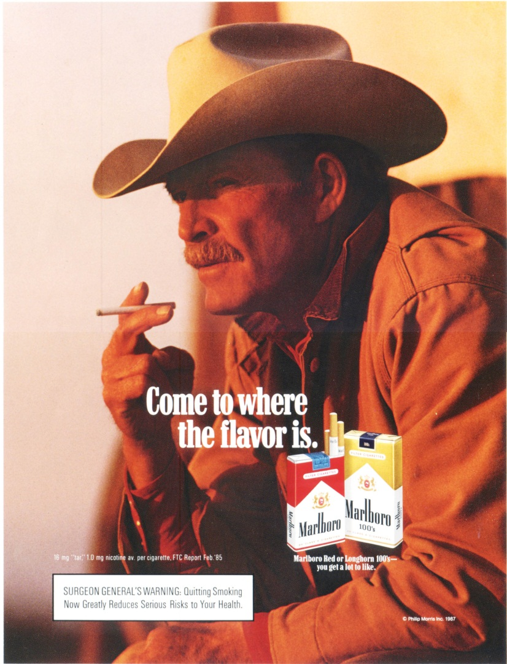
The Burnett Style
“Inherent Drama”
Powerful, instinctive, and long-lasting imagery
Powerful, instinctive

Slide 2
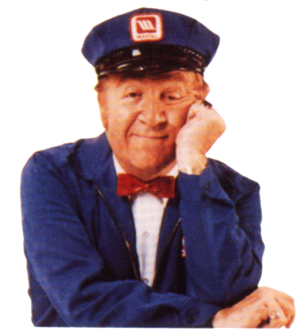
The Burnett Style
“Inherent Drama”
The Lonely Maytag Repairman - a dramatic and engagingly human personification of reliability

Slide 3
The Burnett Style & “Nine wheel logic”
“Inherent Drama”
So, how do you give personality to a can of refrigerated dough?

Slide 4
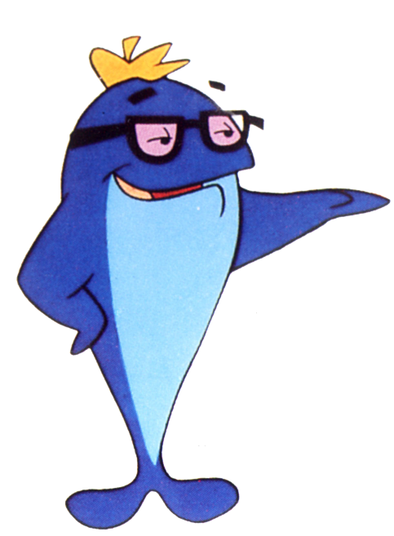
The Burnett Style
“Inherent Drama”
Tuna fish?
Sorry, Charlie, we just want tuna that tastes good.

Slide 5
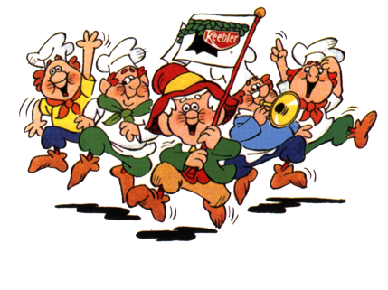
The Burnett Style
“Inherent Drama”
Cookies?
made by elves who live in a hollow tree, and we almost believe it (nine wheel logic).

Slide 6
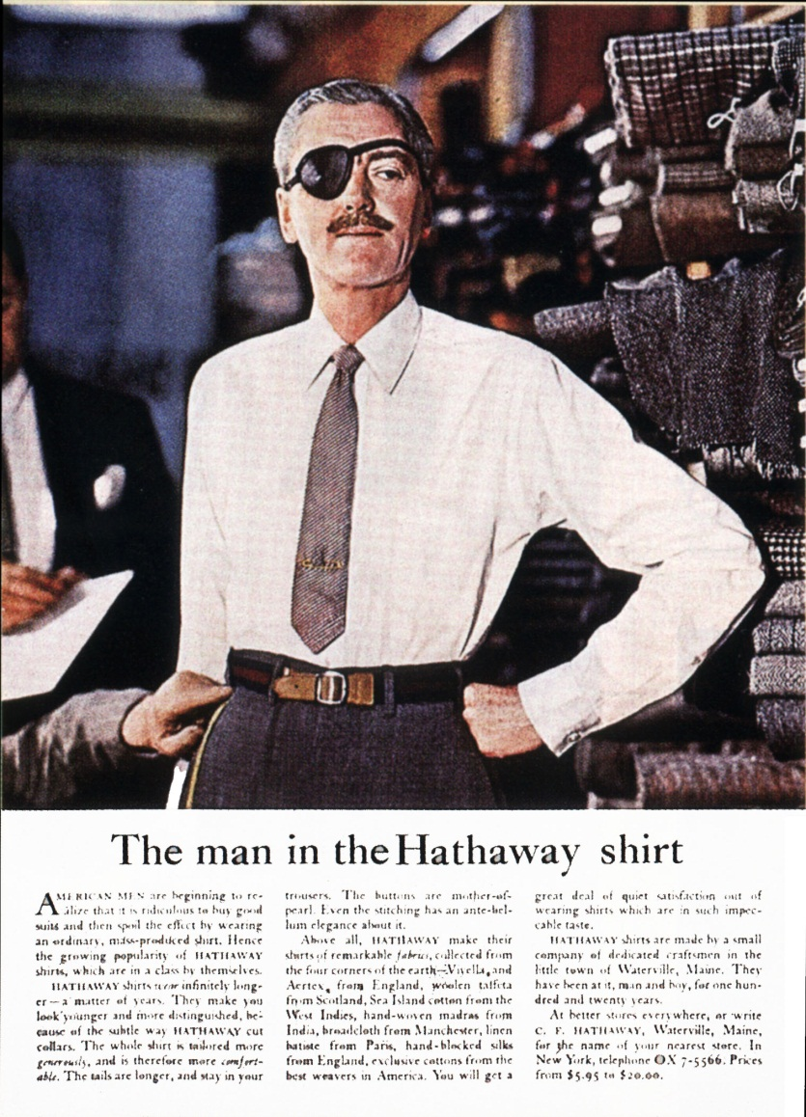
The Ogilvy Approach
Story Value
Imagery - one small device - the eye patch - adds interest for what is just a simple shirt
Current take: “The Most Interesting Man in the World” Dos Equis XX campaign http://www.youtube.com/watch?v=U18VkI0uDxE

Slide 7
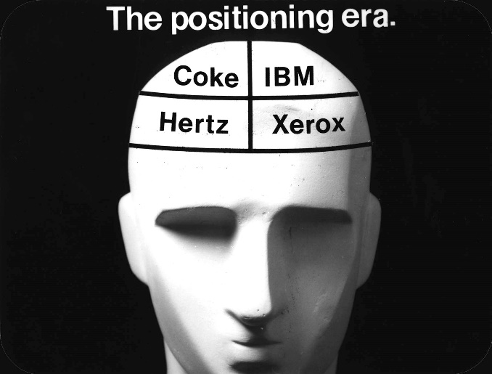
Positioning:
The Marketing Revolution
Positioning was a new perspective on the new marketplace.
There were too many products, and too many messages.
Marketers had to deal with this new reality.

Slide 8
Thus, the goals of advertising
Short term: sale
Long term: brand relationship
Positioning is key
Positioning like advertising occurs in the mind of the consumer, not in the ad itself
How? Stories, success is all about the stories

Slide 9
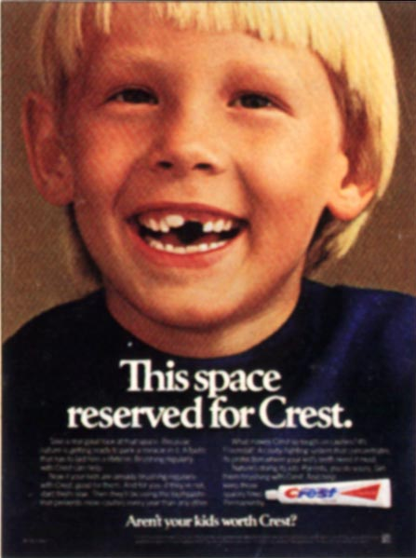
The Best Position
In most categories, there is a #1 in the consumer’s mind
The “Best” Position leverages “Crest”
Can you see the story here?

Slide 10
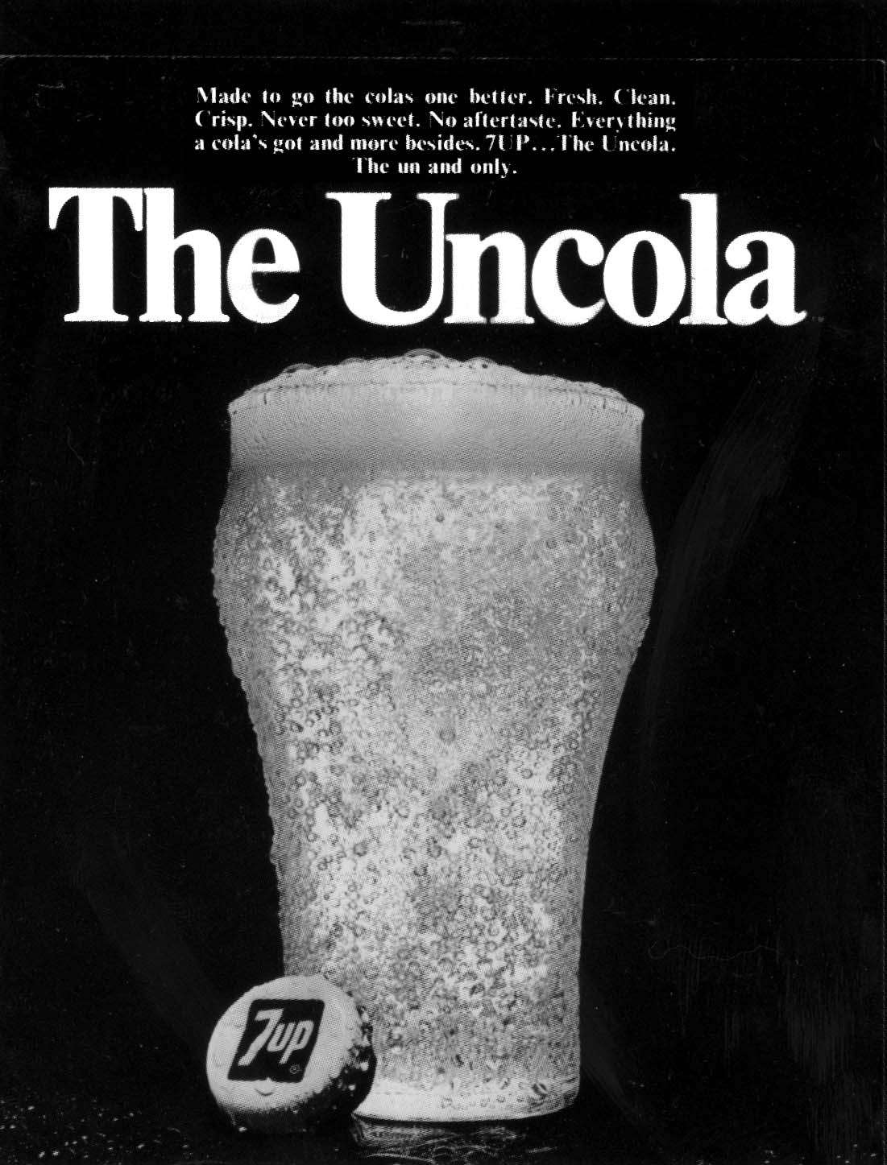
The Against Position
The “Against” Position defines itself vs. #1.
It’s an aggressive and competitive position
The story: your choice to be unconventional
Example: 7Up “The UnCola”

Slide 11
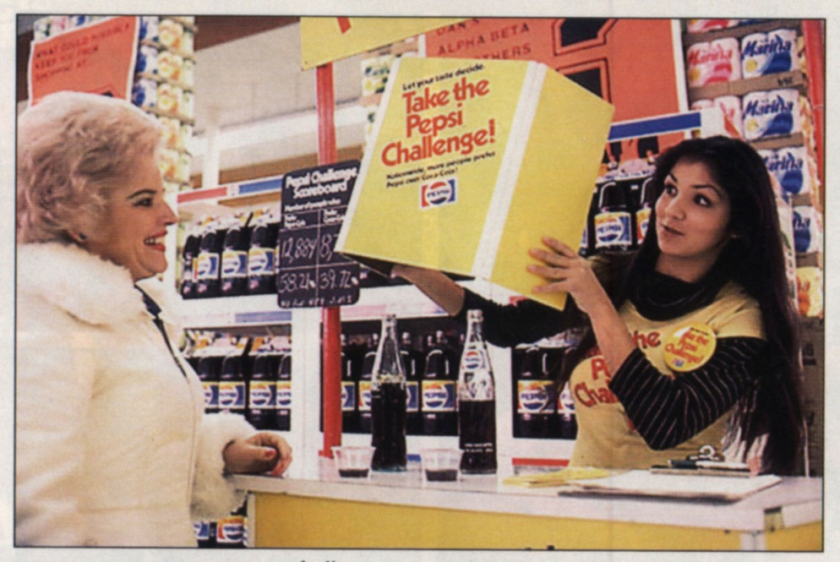
The Against Position
The “Against” Position defines itself vs. #1.
It’s an aggressive and competitive position
Take the Pepsi Challenge-people preferred Pepsi but still bought Coca-Cola
Interesting story: people preferred the taste of Pepsi but still bought Coke!

Slide 12
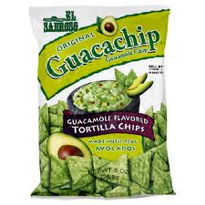
The Niche Position
The “Niche” Position promotes the product along one dimension of superiority
Example: Guacachip
Image: houston-imports

Slide 13
The New Category
The New Category is just that. It defines a category that didn’t exist before and then positions the (new) product as the best in that new category. Competition follows.
Example: ipads www.apple.com

Slide 14
But now . . .
A cluttered market
A cynical consumer
Too many choices and not enough time
Image: valdosta.edu

Slide 15
Media + Advertising + Ethics
Advertising Appeals
Digital revolution: be careful what you ask for
Story is king with sophisticated, savvy, and cynical consumers
Products we consume, brands we support, media we watch, and stories we relate/tell each other: http://www.youtube.com/watch?v=tl6YOYdBiQ4
Our culture, learned from school, parents, media..
A such, the mass mediated persuasive communications are evolving: shared values with those who are media literate (natives) and those who want to be (immigrants)
Ethics critical to long-term brand relationships

Slide 16
GOT Ethics?
A set of moral values within society that guide thinking and action
Ethics are dynamic
Ad is unethical if it:
Degrades the competition
Gives false or misguiding information
Is obscene or immoral
Violates public interest

Slide 17
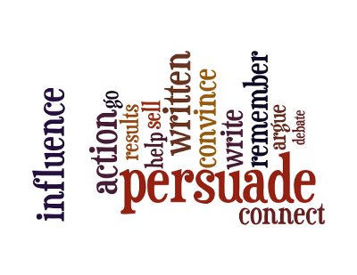
Aristotle's Three Appeals
384 - 322 B.C.E.
Logos, Pathos, Ethos
Image: recoveringengineer.com

Slide 18
LOGOS
Appeals to the intellect and logic
Statistics, facts, and logical reasoning
Authorities are cited
Information offered
Theory, principles evoked
Comparisons
Image: downk.wordpress.com

Slide 19
PATHOS
Emotions
Joy, elation, celebration, accomplishment
Anger, fear, sadness
Romance and sex appeal
Desire for membership & approval
Humor-- wit to slapstick
Image: Humane Society, March 5, 2011, retrieved from Humanesociety.org

Slide 20
ETHOS
Appeal of character and virtue
Your character, training, title and expertise are established through tone and references
Name brand recognition
Image: atunl.blogspot.com

Slide 21
Advertising Strategy
Persuasive writing OR writing that understands the reader
A skilled craft with an artistic flourish
Verbal Carpentry
Words on Paper
Salesmanship=Strategy + Structure+Style

Slide 22
How to Write Persuasively
“Strategic Development” is about ways of thinking
Purpose: solve a problem
Understand your audience: gen x, y, z, c, etc.
Media choice
A Strategy is a Hypothesis
It is a guess how to get somewhere
Uses a wide variety of thinking techniques

Slide 23
Thus . . .
An Advertising Strategy simply means what your advertising should communicate to whom
Most importantly, think about the person you are trying to persuade

Slide 24
Advertising tactics
The “executions” or “deliverables”
Traditional: Print, radio, television, out-of-home
Versus Non-traditional: Non-Traditional is designed to cut through the clutter of traditional advertising to grab the attention of customers.
Relies on creativity and innovation to get the message heard.
Catches consumers off guard with ads that can’t be ignored.

Slide 25
Be careful of social media and be careful of what you ask for.
Chapstick: Be Heard
Be heard (but only if it is what we want to hear) Forbes article:
http://margotmagowan.wordpress.com/2011/10/20/chapstick-sticks-it-to-women-by-melissa-spiers-guest-post/
Chapstick we’re through:
http://blog.pigtailpals.com/2011/10/dear-chapstick-were-through/
Reel Girl blog: http://margotmagowan.wordpress.com/2011/10/20/chapstick-sticks-it-to-women-by-melissa-spiers-guest-post/

Slide 26
Ethical Considerations
Ethics are critical to long term brand relationships
Too many consumer choices/brands to play false with consumers
Be persuasive (appeals to needs/desires) but not manipulative
People in advertising spend a lot of their time dealing with ethical choices. Because ads are made of choices: What to show ... and what not to show. What to say ... and how to say it. Who to put in the ad ... and who not to.
There's a difference between the pure truth and the useful truth
Truth in advertising: Sometimes lying builds trust
How a brand actually behaves counts more than what they say.
Due to the Internet, the most influential voices in advertising is you. You hear about a product, so first to check out the opinion of your peers.
Advertisers need to tell the truth, but not always the whole truth-can we handle the truth?

Slide 27
Where is advertising headed?
Robert Liodice, president and CEO of the Association of National Advertisers, [the trend towards digital] will continue to evolve. "The dream for marketers is to market to consumers on a one-to-one basis.”
"[Digital is] waste-free," says David Kenny, managing partner of Publicis Groupe's VivaKi and one of the holding company's top media chiefs. "It doesn't scream and shout at people, but rather it has true potential to add meaning to their lives by connecting when and where people are most receptive to the content and messaging." http://www.markramseymedia.com/2009/08/where-is-advertising-headed/

Slide 28
The future is now
Augmented reality
https://www.youtube.com/watch?v=Gle4Y63yGxQ
Virtual reality: Coca-Cola VR sleigh ride
https://www.youtube.com/watch?v=bTbfPALVQgs
Digital interaction
https://www.youtube.com/watch?v=2lXh2n0aPyw
The power of digital is in transformational change, not additive garnish. Tom Goodwin. AD CEO
Advertising in 2020 will not be buy me, it will be join me. Kevin Allen, AD CEO
Technology will make things easier for sure, but the need for human creativity across the marketing landscape will still play a critical role in tapping into consumer psyche and driving action. Sarah Hofsetter, CEO

Slide 29
Furthermore
When you can connect with consumers one-to-one you can then better understand consumers, but most importantly they understand the product or service you offer. (logos)
They will trust you because you show you understand them. They can "raise their hands" to participate with you in your shared interests. You can solve the problems you know they have – rather than the ones you hope they have. (ethos)
Advertisers must remember that what is most important is the quality of the relationship with consumers, not simply the quantity, that matters most. (pathos)

Slide 30
So, then . . .
Advertising is about establishing a relationship.
The best relationships are built on mutually satisfying goals (shared values)
Tell me how I benefit (what’s in it for me) truthfully, give me a reason to believe (even if nine wheel logic), and do so in just a few seconds
And, relate your product or service to my life (resonance).

Slide 31
And . . .
Whoever tells the best story wins.
Transmedia can be used to create storyworlds around brands, and to generate a wholesome consumer brand experience based on a narrative rather than short-lived promotions i.e. nike plus app.
A brand storyworld should give consumers the opportuntity to explore on their own terms.
A brand storyworld is based on non-linear storytelling.
Ideally, a branded storyworld should exceed the sales estimates of traditional marketing techniques http://christineweitbrecht.com/

Slide 32
Our stories reflected through:
Products we consume, brands we support, media we watch, and stories we relate/tell each other: http://www.youtube.com/watch?v=tl6YOYdBiQ4
Our culture, learned from school, parents, media..
As such, the mass mediated persuasive communications are evolving: shared values with those who are media literate (natives) and those who want to be (immigrants)
From fairy tales
To Augmented reality

Slide 33
Overall . . .
Love it or hate it advertising both reflects the desires of consumers and showcases culture
Like all communication forms offers benefits and creates problems

Slide 34
Some of my favorites . . .
Tribute to soldiers: http://www.youtube.com/watch?v=eTxT7feUlPg
Puppy love http://www.youtube.com/watch?v=uQB7QRyF4p4
Rihanna http://www.youtube.com/watch?v=iyy4wn3E730
Charlize Theron & AR with a little help from some friends http://www.youtube.com/watch?v=mXrWiJcmvBI

Slide 35
Questions? Comments?

Slide 36
References
Bedinger, B, (2010). Advertising and the business of brands. www.adbuzz.com
www.apple.com/ipad/gallery/
www.dosequis.com
http://recoveringengineer.com/communication-skills/five-secrets-for-more-persuasive-writing/
http://weburbanist.com/2008/08/27/15-amazing-dramatic-guerrilla-marketing-campaigns/
http://www.slideshare.net/mohamednassar/non-traditional-advertising
http://www.apple.com/ipod/nike/sync.html
Ohler, J. www.jasonohler.com
Prensky, M. Digital native, digital immigrants. http://www.marcprensky.com/writing/prensky%20-%20digital%20natives,%20digital%20immigrants%20-%20part1.pdf
http://www.aef.com/on_campus/classroom/speaker_pres/data/6000

