Slide 1
Advertising in Action
And just maybe, more than you ever wanted to know about advertising
Carrie Perry
Fielding Graduate University
cperry@email.fielding.edu

Slide 2
Overview
Advertising Overview
Really, really, really brief history of advertising (100 years in about 5 minutes)
Goals of advertising
Advertising appeals: Aristotle+ post-modern, Jib Fowles
Advertising Strategy
Advertising Tactics (AKA “Deliverables”) traditional (print, tv, radio, billboards) and non-traditional (interactive, web-based, guerrilla)
Future-impact of DVR’s, product placement, cell phones, ap advertising, shared value advertising

Slide 3
Let the record state that . . .
The following discussion will focus on the HISTORY of advertising, NOT on-
Whether advertising should exist
The relative evils of advertising
Whether advertising manipulates consumers
Or, if advertising should be banned.

Slide 4
Once upon a time . . .
Then & Now | 100 Years of Chevrolet | Chevy Centennial – YouTube
http://www.youtube.com/watch?v=oeas5jtffpM

Slide 5
Once upon a time
It all started in Babylon and the first ad was for wine.
Advertising in the civilized world consists of variations on signs, pitchmen (later known as town criers) and sponsored public works for the next 3500 years.
Egyptians used papyrus to create sales messages and wall posters, while lost-and-found advertising on papyrus was common in Ancient Greece and Ancient Rome.
Wall or rock painting for commercial advertising is another manifestation of an ancient advertising form, which is present to this day in many parts of Asia, Africa, and South America.
The tradition of wall painting can be traced back to Indian rock-art paintings that date back to 4000 BCE (http://www.xtimeline.com/evt/view.aspx?id=79892)
Notes:
Babylonians introduce the first known forms of advertising--store signs and street barkers. Babylonians also invent "sponsorships," allowing kings to stencil their names on the temples they'd constructed. The tradition of wall painting can be traced back to Indian rock-art paintings that date back to 4000 BCE (http://www.xtimeline.com/evt/view.aspx?id=79892

Slide 6
Then came the printing press
Guttenberg changed the world (and gave a huge boost to advertising)
Let’s fast forward to the 1900s when advertising became serious business.

Slide 7
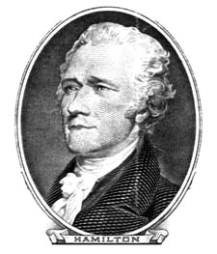
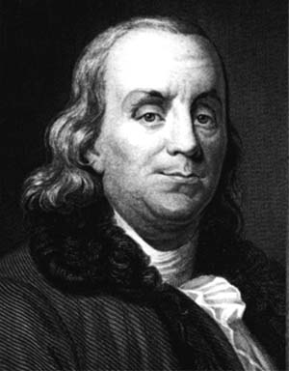
2 Founding Concepts:
The Power of Ideas
Benjamin Franklin-printer and idea person
Alexander Hamilton-U.S. as a business partner

Slide 8
Four A’s of Modern Advertising
Attention-cut through the clutter
Awareness-and then make it real
Attitude-to create a positive “feeling”
Action-so the consumer acts
All equals resonance

Slide 9
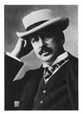
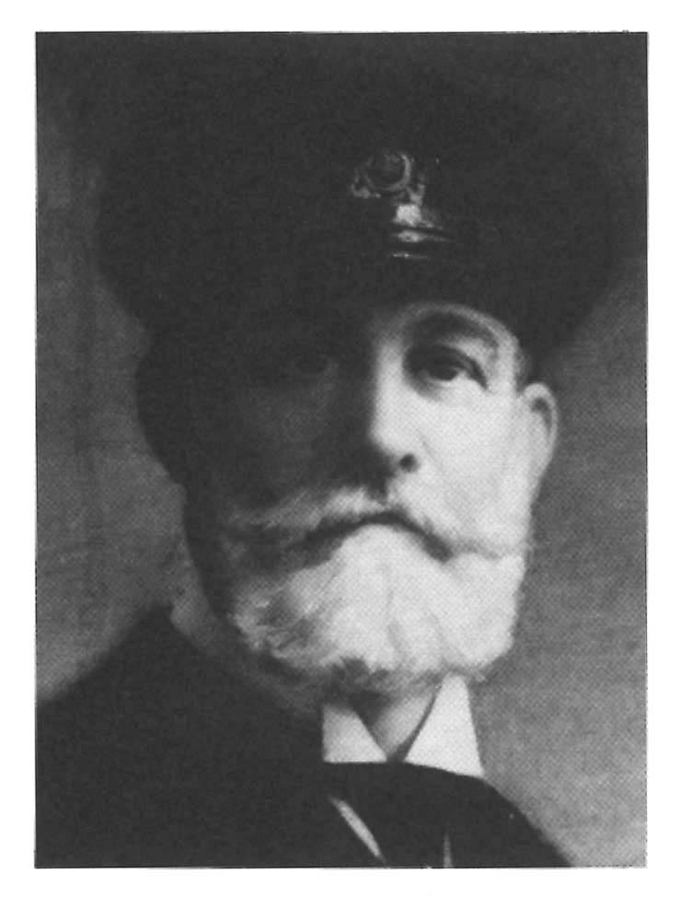
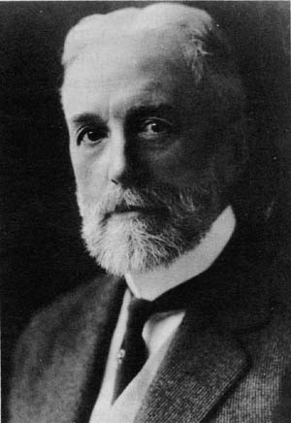
3 Very Big Ideas!
1 Big Product Idea - King Gillette
2 Big Media Idea - J. Walter Thompson
3 Big Business Idea - Cyrus Curtis

Slide 10
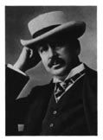
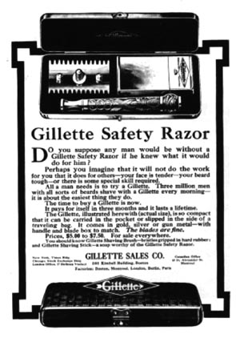
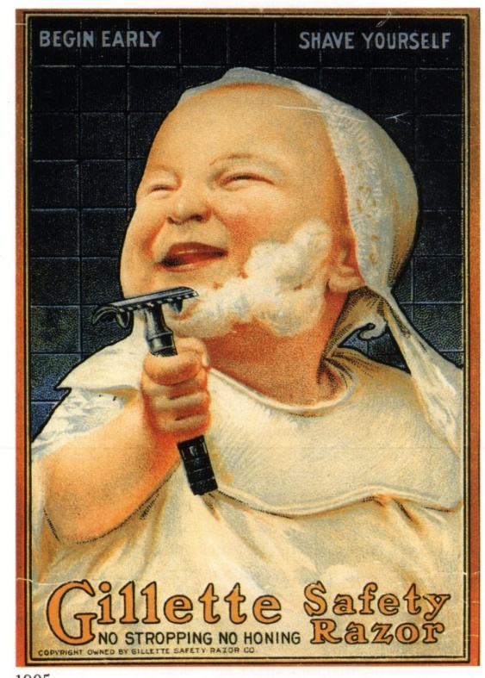
King Gillette’s Big Idea!
Make a product that must be re-purchased
Advertise it aggressively
Gillette becomes one of first
“packaged goods”

Slide 11
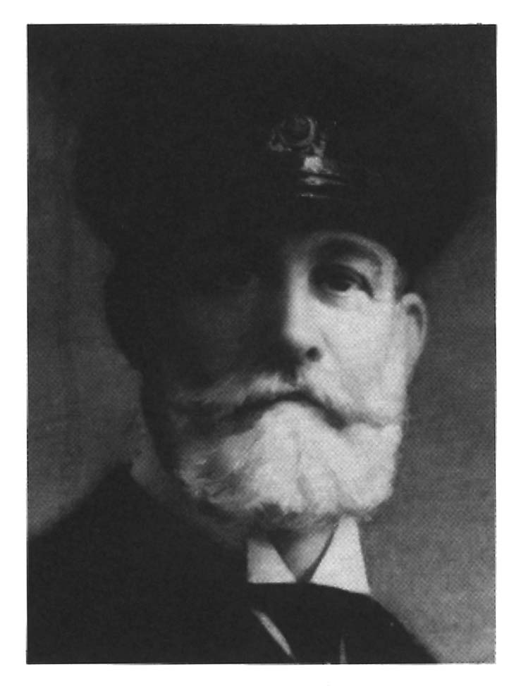
J. Walter Thompson’s Big Idea!
Sell ad space in magazines
Pocket a commission
JWT becomes key agency
And...
Magazines become a national ad medium!

Slide 12
Cyrus Curtis’s Big Idea!
Have agencies sell ad space in your magazines for you
Only agencies can pocket a commission (clients can’t)
Curtis Publishing Becomes Big!
Ad Agency Business is Established!!

Slide 13
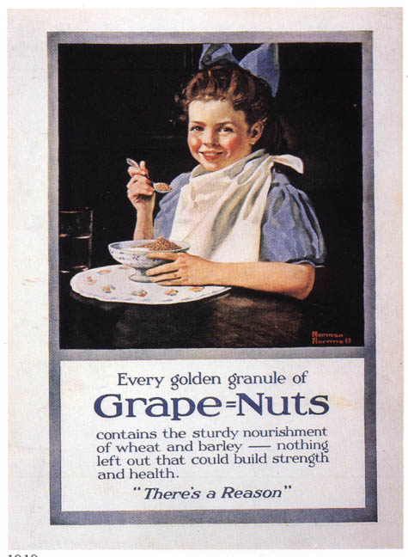
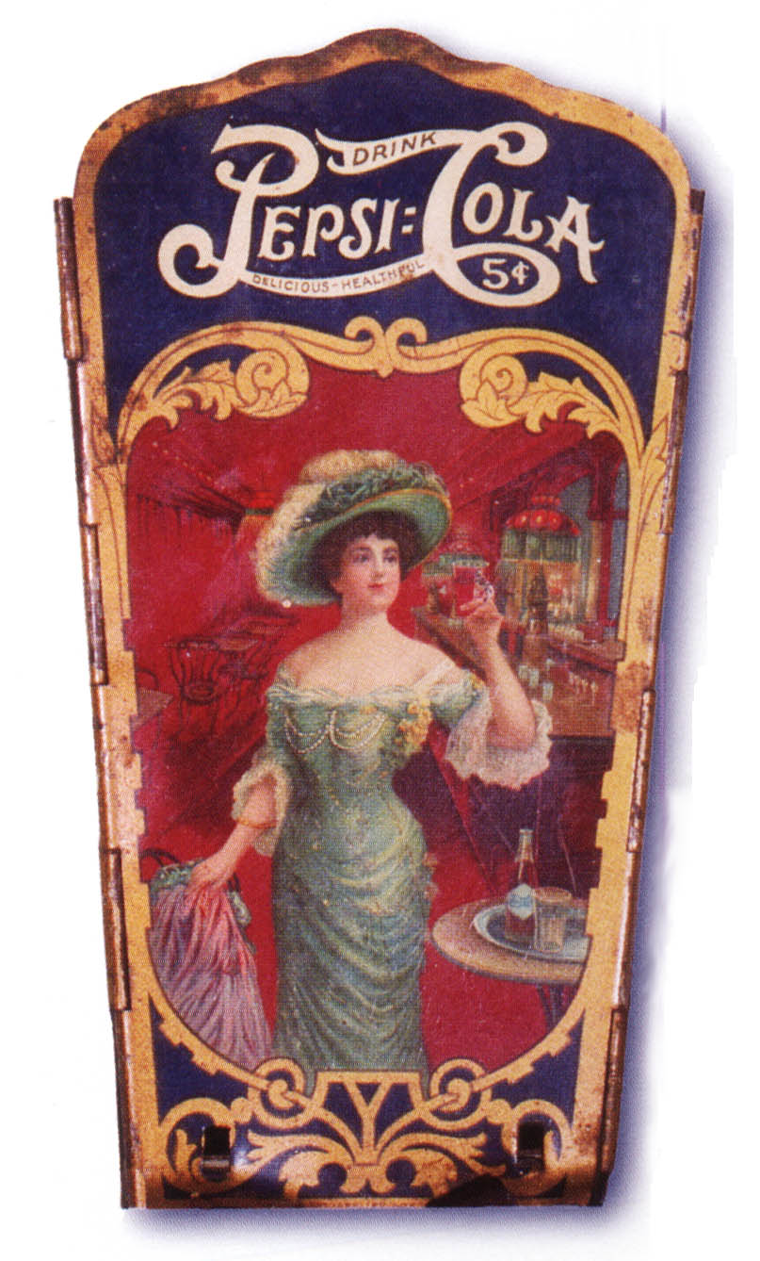
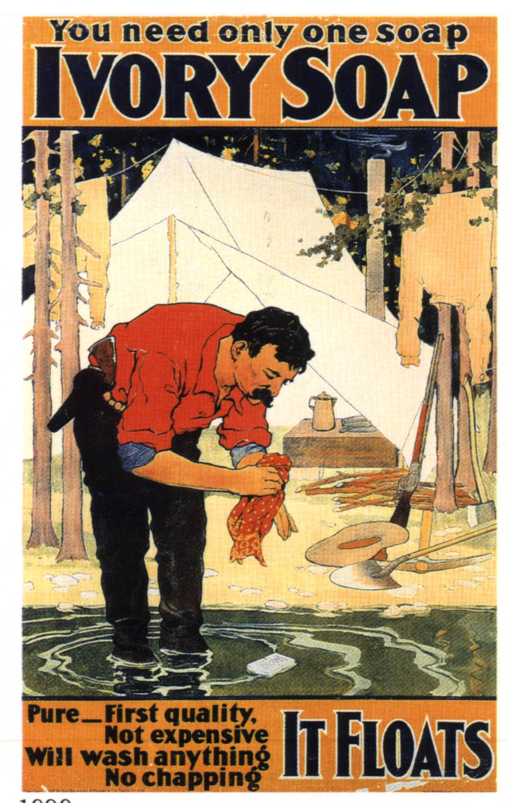
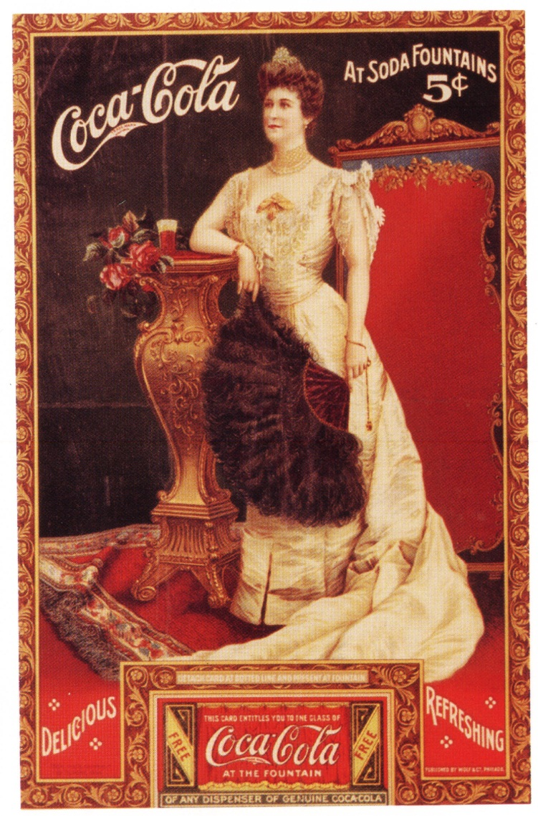
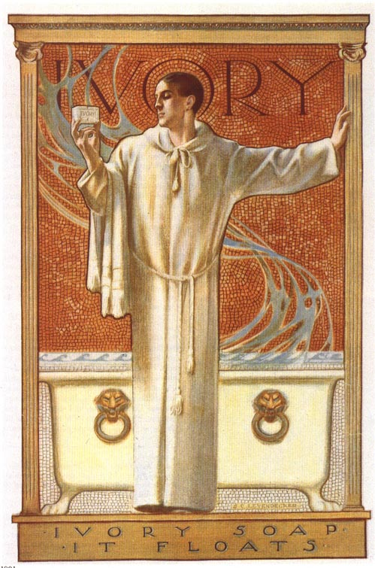
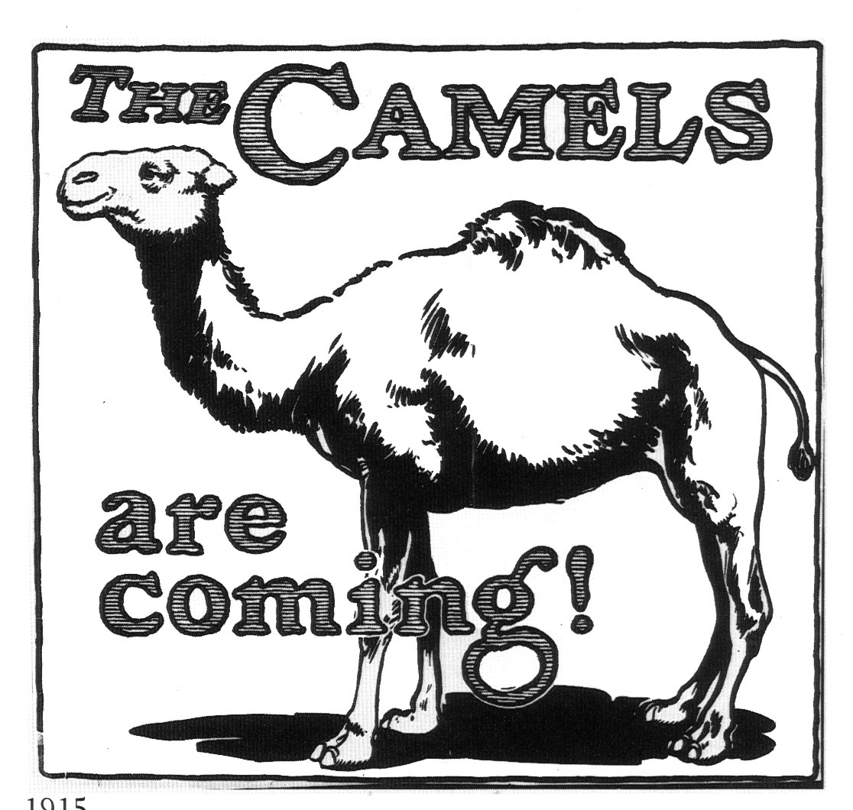
Many Early Ads Were Posters
Soaps
Soft Drinks
Cereals
Cigarettes

Slide 14
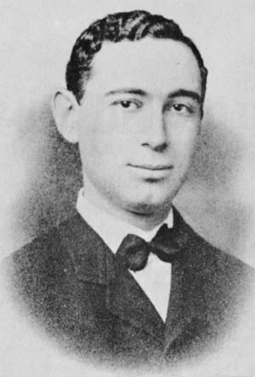
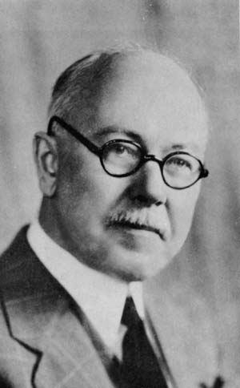
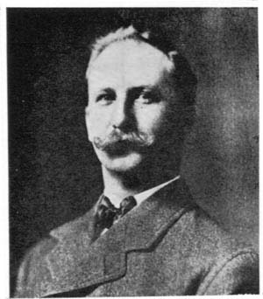
Ad Evolution 1900-1920
The “Age of Lasker”
Lasker Hears a Big Idea...
“Advertising is salesmanship in print.”
John E. Kennedy “reason-why” advertising
Claude Hopkins
“Scientific Advertising”

Slide 15
Lasker: father of Modern Advertising
Copy created to appeal the psychological interests of the consumer
Changed pop culture forever
Understand that you must pre-empt the consumer to think differently about a product.
Show the consumer why they may want or need an item.

Slide 16
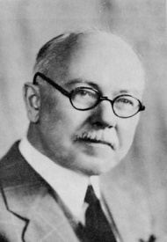
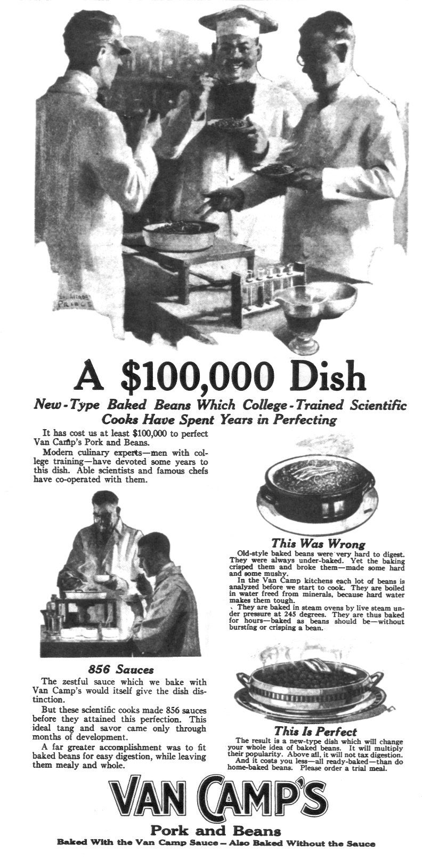
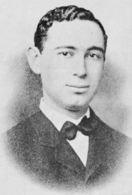
Lasker’s Ads
Created by
Claude Hopkins
Hopkins’ “pre-emption”
Baked Beans
Cereal

Slide 17
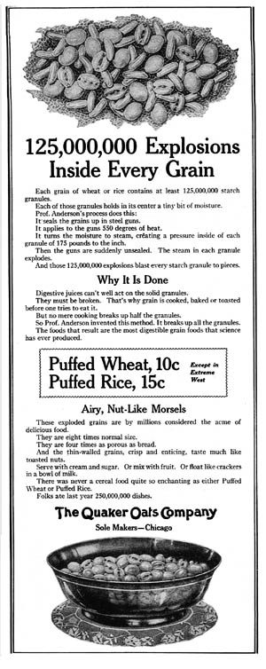
Lasker’s Ads
Created by
Claude Hopkins
Hopkins’ “pre-emption”
Baked Beans
Cereal
Shaving Cream

Slide 18
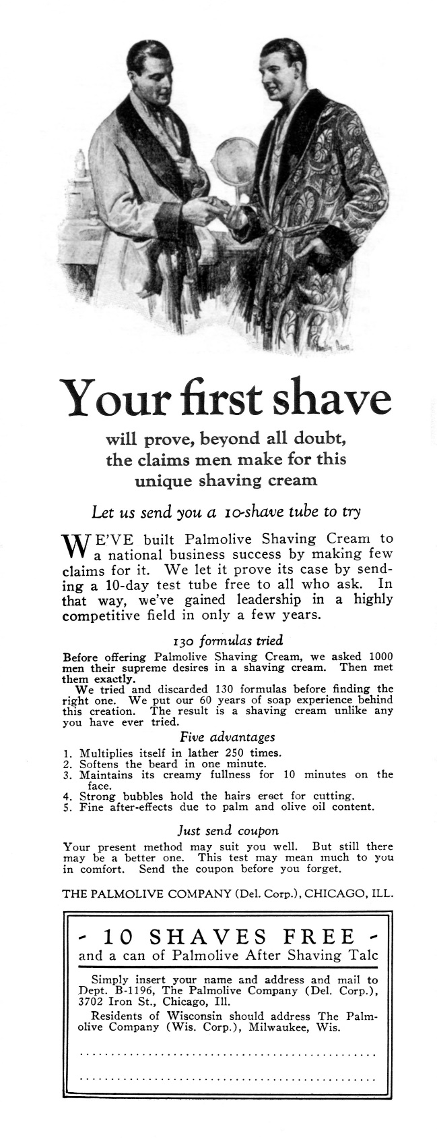
Lasker’s Ads
Created by
Claude Hopkins
Hopkins’ “pre-emption”
Baked Beans
Cereal
Shaving Cream
Orange Juice

Slide 19
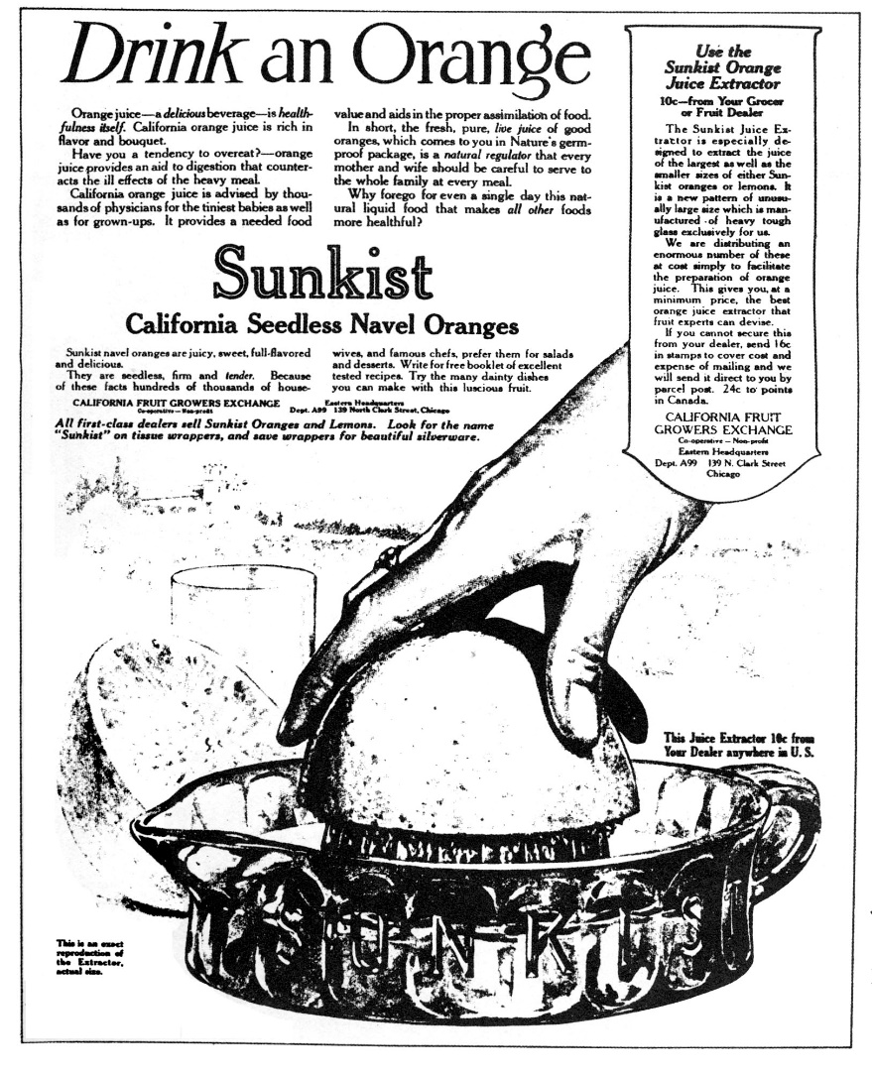
Lasker’s Ads
Created by
Claude Hopkins
Hopkins’ “pre-emption”
Baked Beans
Cereal
Shaving Cream
Orange Juice- started an infatuation
Note: when products are new, advertising about those products can be very interesting.

Slide 20
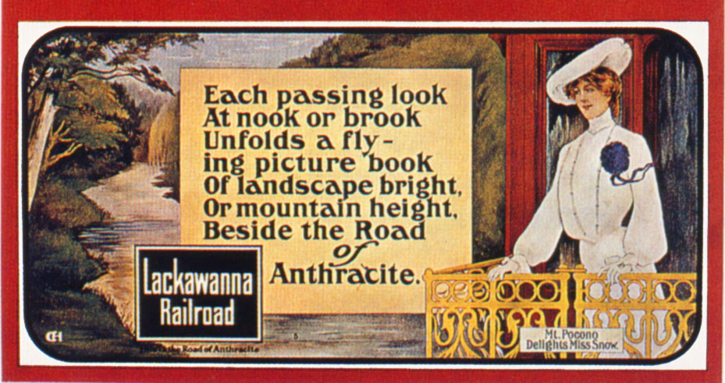
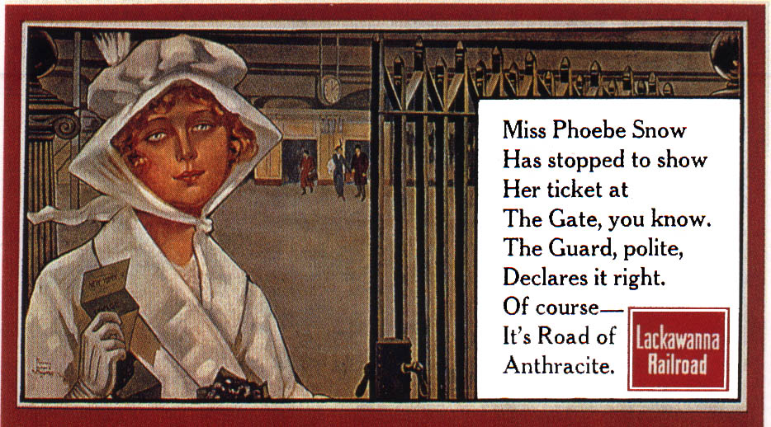
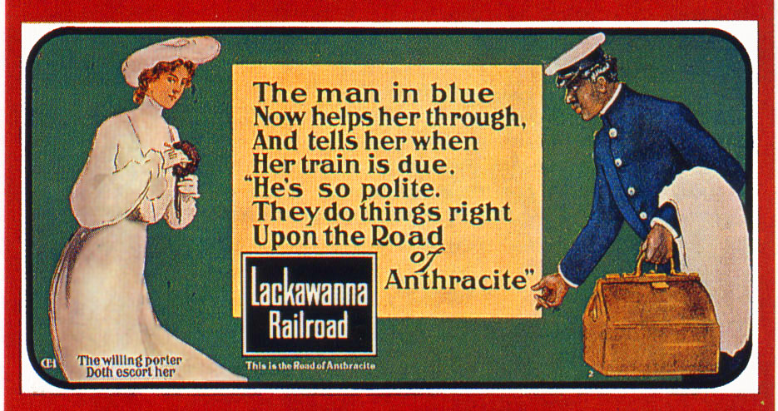
Early “Pull Advertising” Kennedy’s “reason why”
Elmo Calkins & “Phoebe Snow”
Dressed in white - “Road of Anthracite”

Slide 21
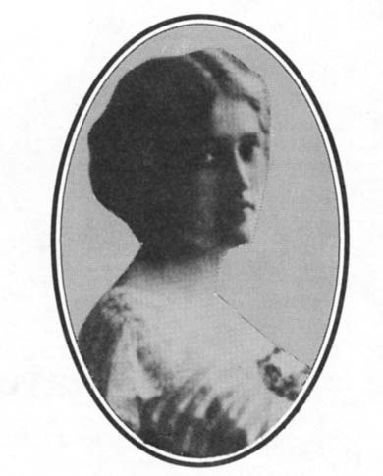
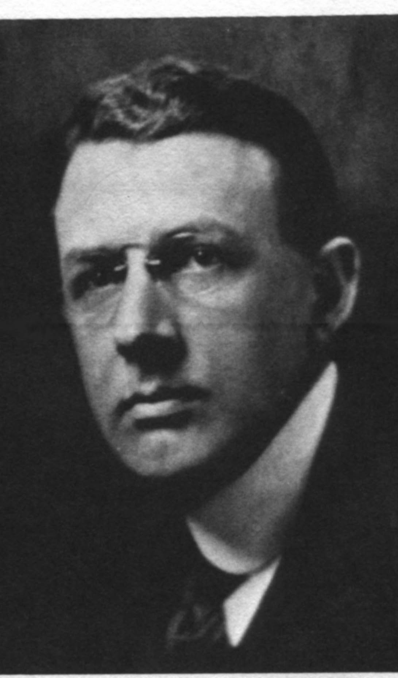
JWT’s Creative/Business Team
Helen Resor
HS Valedictorian
Strong writing -
“A skin you love to touch"
Suffrage Leader
Stanley Resor
Professionalism
Partnership

Slide 22
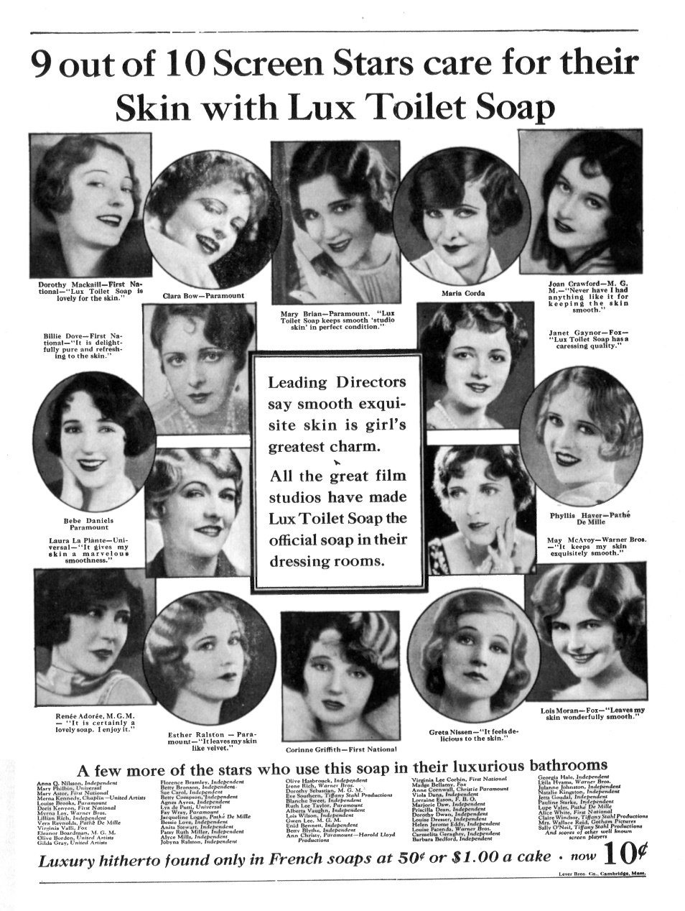
JWT’s Creative
JWT Understood
the Power of Testimonials
and Celebrity Endorsement.

Slide 23
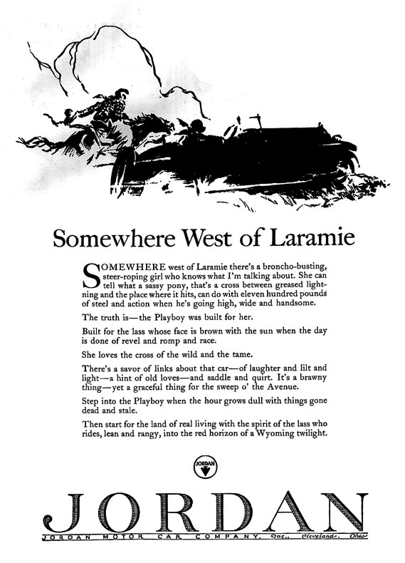
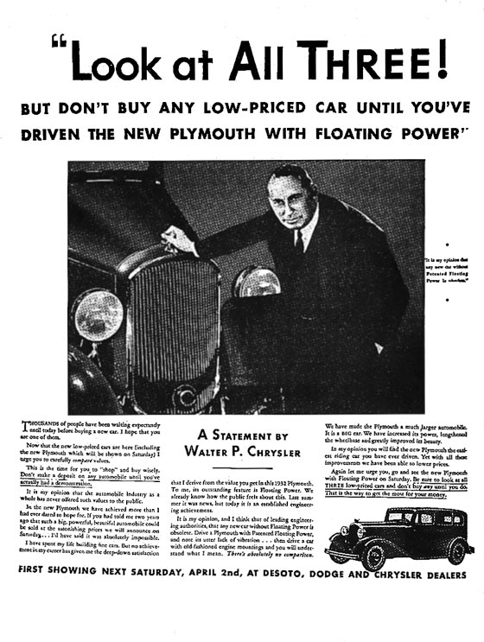
“Pull” vs. “Push”
Example: Jordan
Imagery and “word magic”
Works best when times are good
Pushing Plymouth
Positioning and competing
Works best when times are tough

Slide 24
John Caples’ Direct Approach
Father of Direct
www.caples .org
Major awards for direct response marketing
Learned and Shared Lessons of Direct
Initial Involvement
Best delivery of benefit
John Caples of BBDO

Slide 25
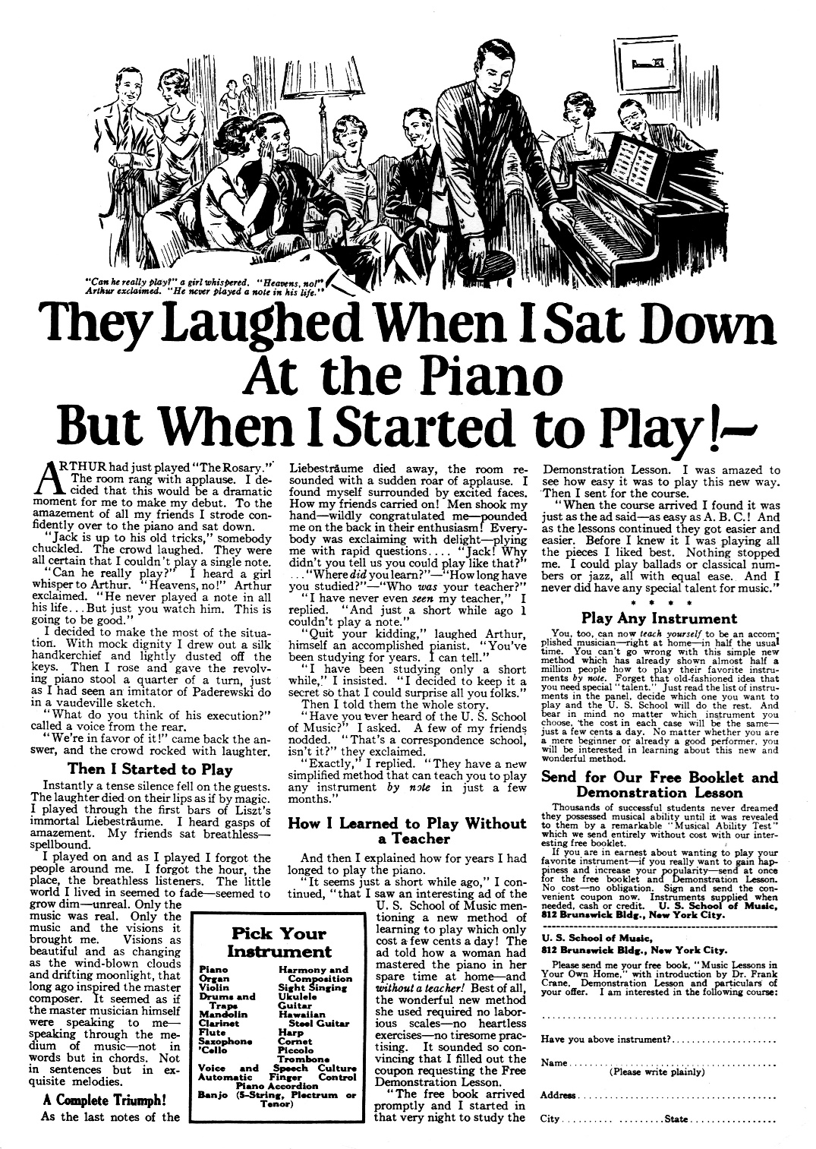
John Caples
John Caples of BBDO

Slide 26
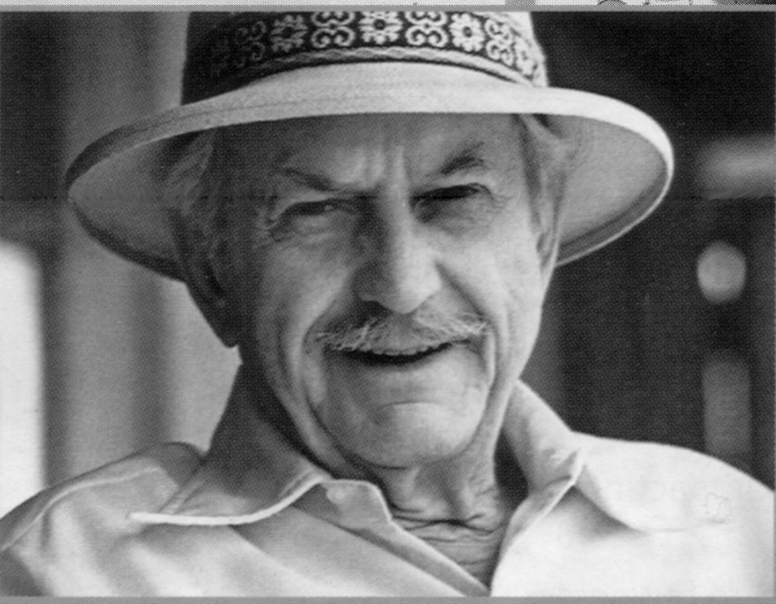
Ray Rubicam (Young & Rubicam)
Creative Control of Advertising
Used Research w. George Gallup
Writer/Art Director Team - New Standard
Ethical Behavior
First Modern Agency

Slide 27
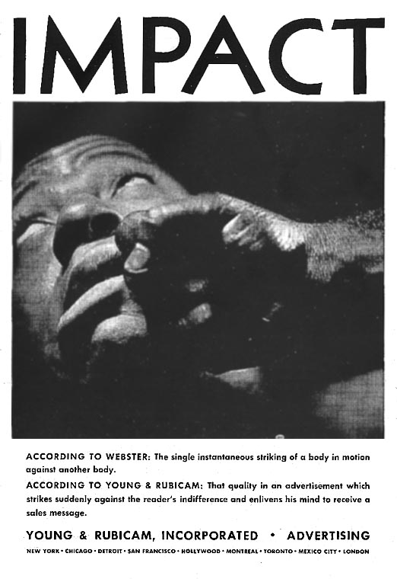
Ray Rubicam
This Ad was done in 1939!
Power of Words + Visual
Still looks contemporary.

Slide 28
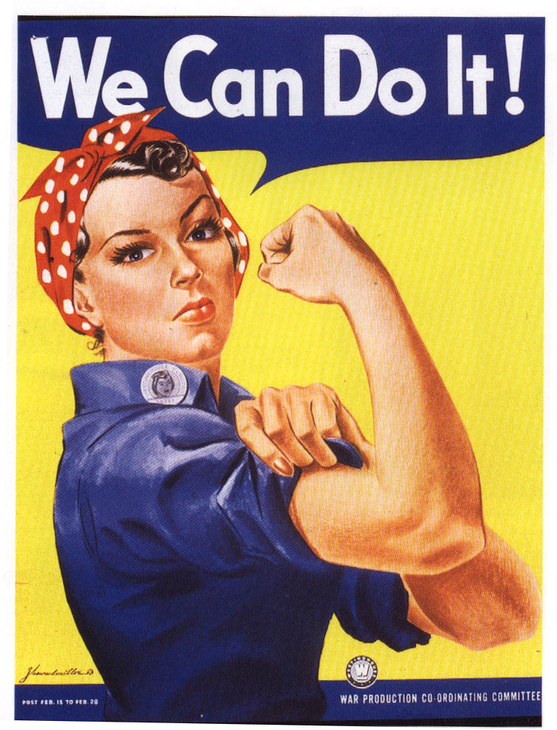
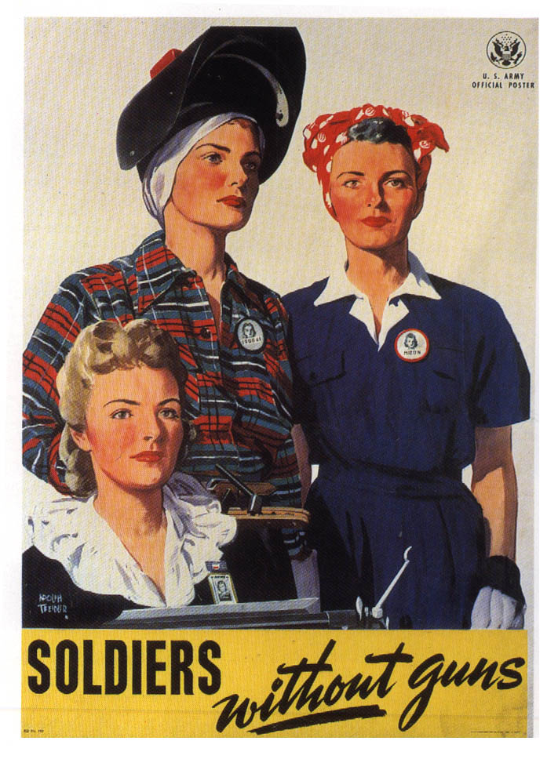
Advertising Goes to War!!
War Advertising Council
Part of Social Change - women in work force
Image Advertising (product shortages)

Slide 29
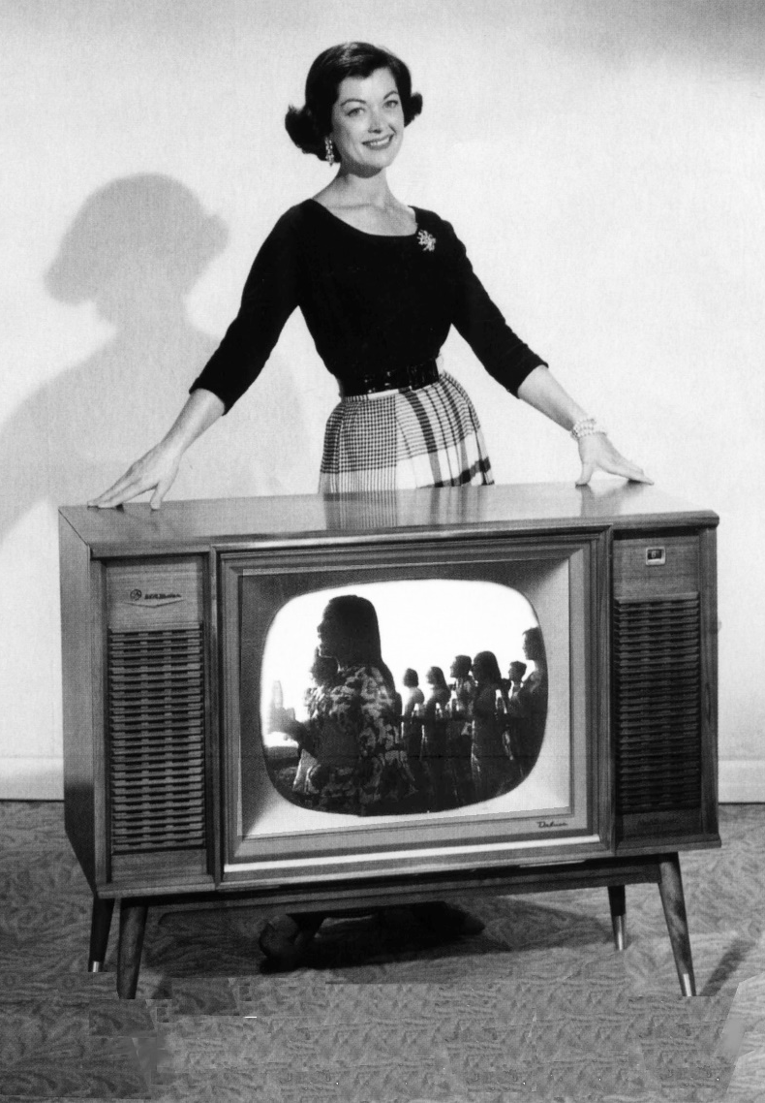
The New Ad Medium - Television!!
Increased Post-War Consumption
Increased Ad Spending (up 300%!)
Increased Agency Size
“Modern” age of advertising begins...

Slide 30
The Creative Revolution: As society changes so does advertising
1960-1969 - Cultural Forces
Countercultural movements
“Break the rules”
1950-1969 - Business Forces
A New Breed of Agencies
A New communication style
Three Influential individuals...

Slide 31
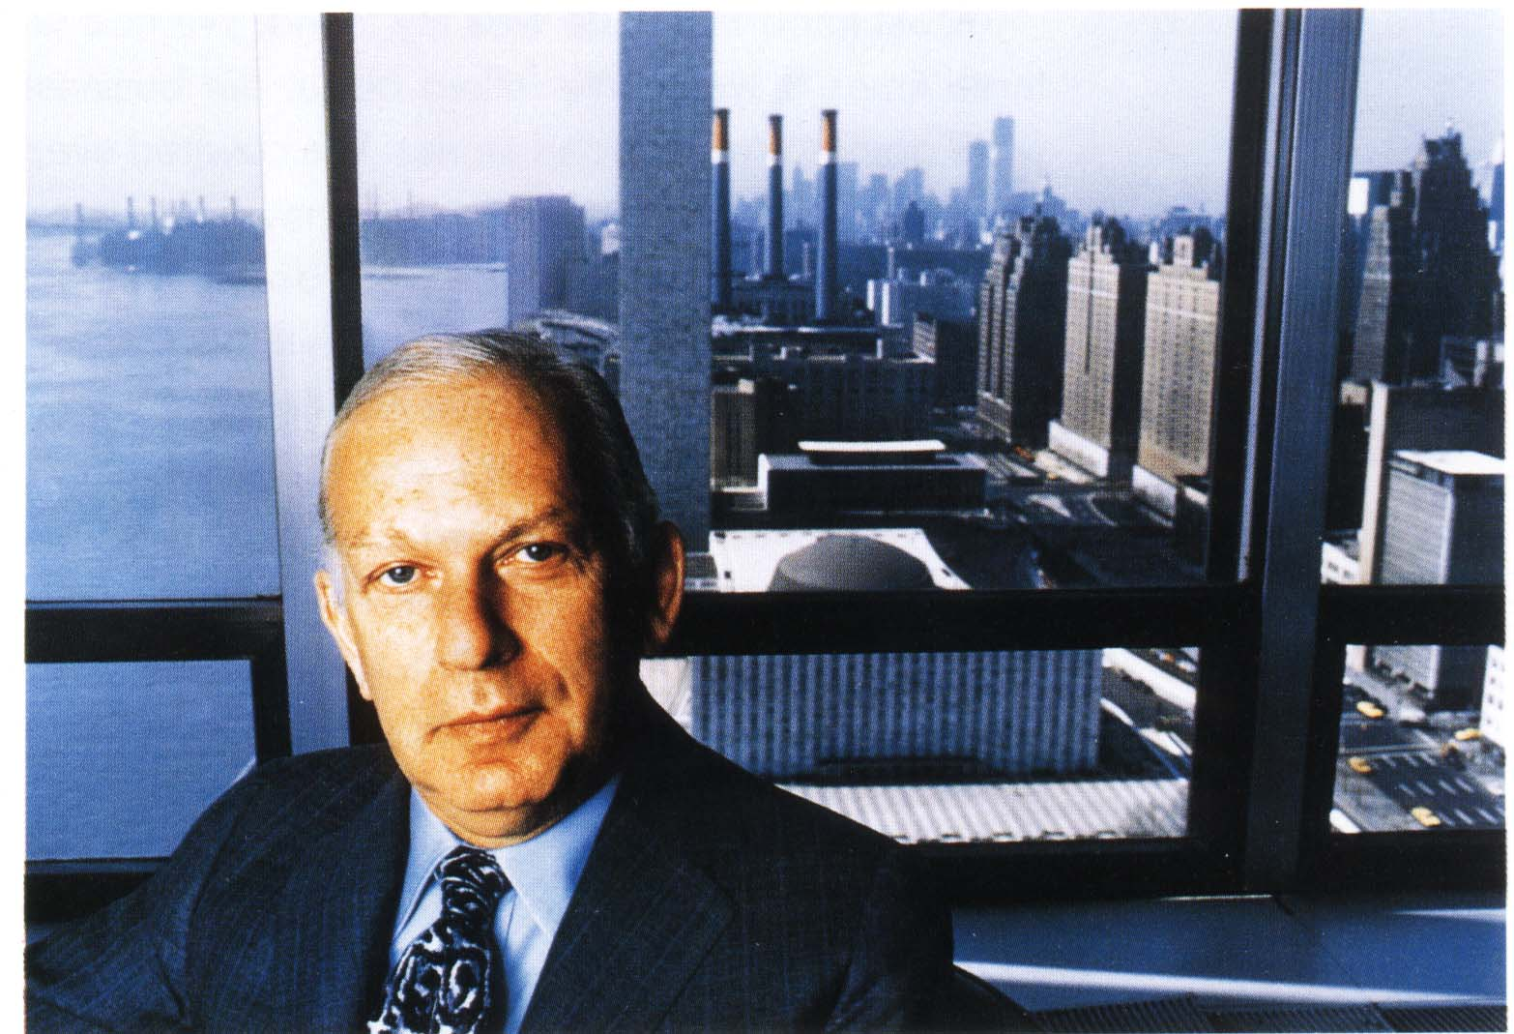
Three Key Individuals
Bill Bernbach, Doyle Dane Bernbach (DDB)

Slide 32
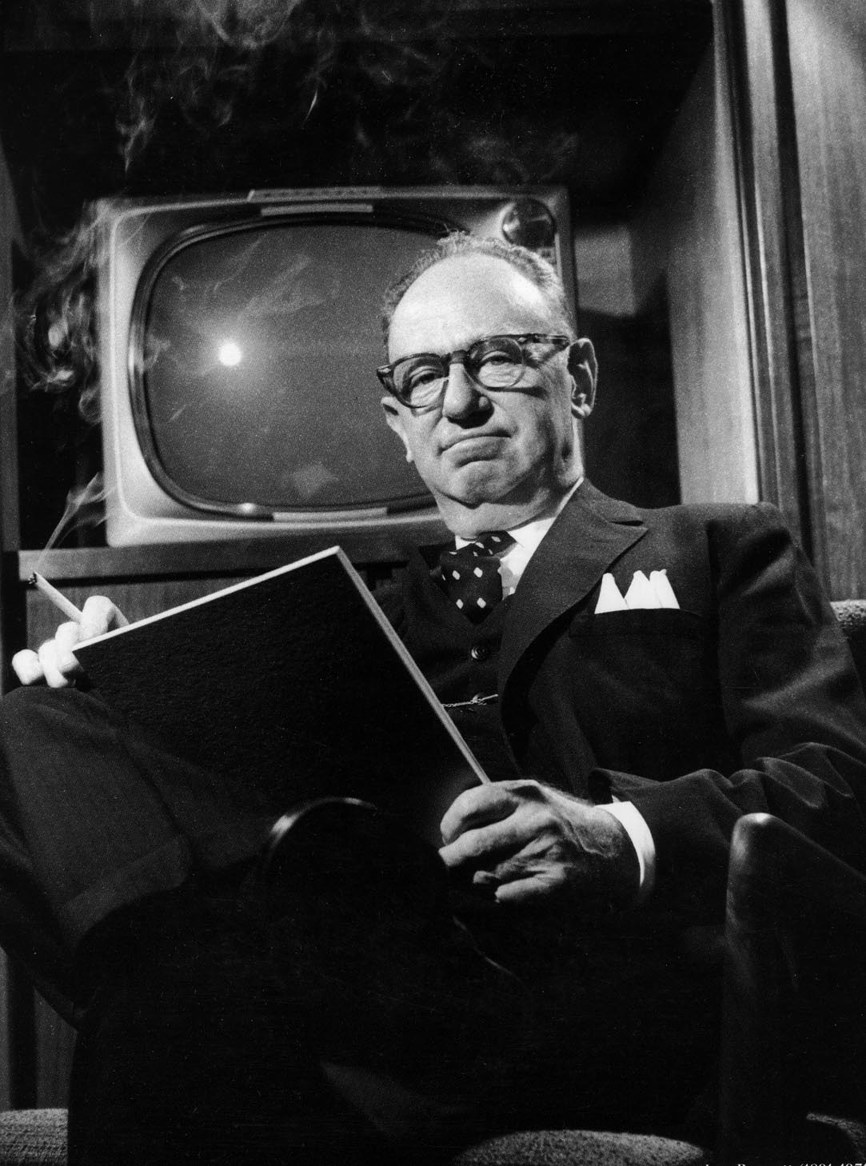
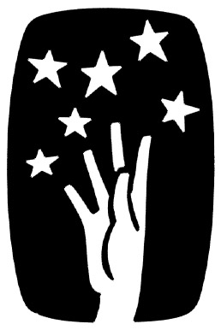
Three Key Individuals
Leo Burnett, Chicago, IL
“If you reach for the stars, you might not get one, but you won’t come up with a handful of mud, either.”

Slide 33
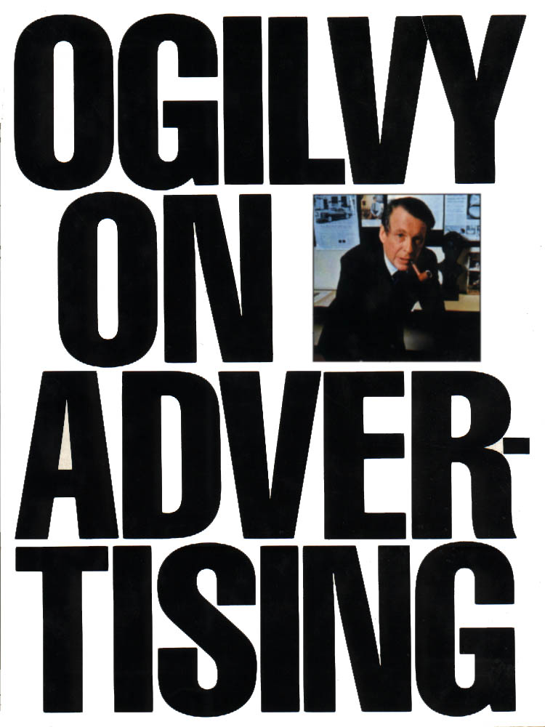
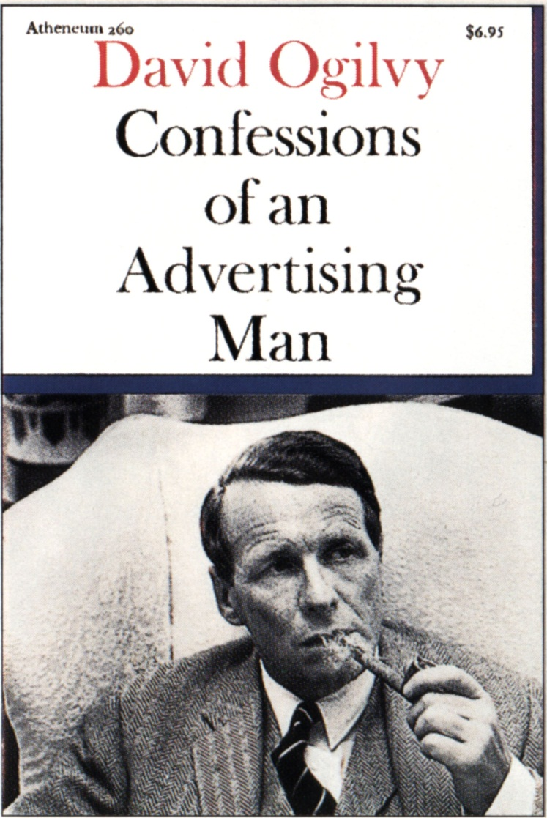
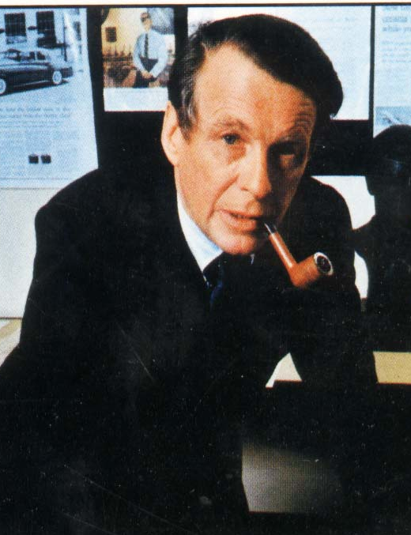
Three Key Individuals
David Ogilvy
Came from UK to start agency – Ogilvy & Mather
Wrote books about advertising

Slide 34
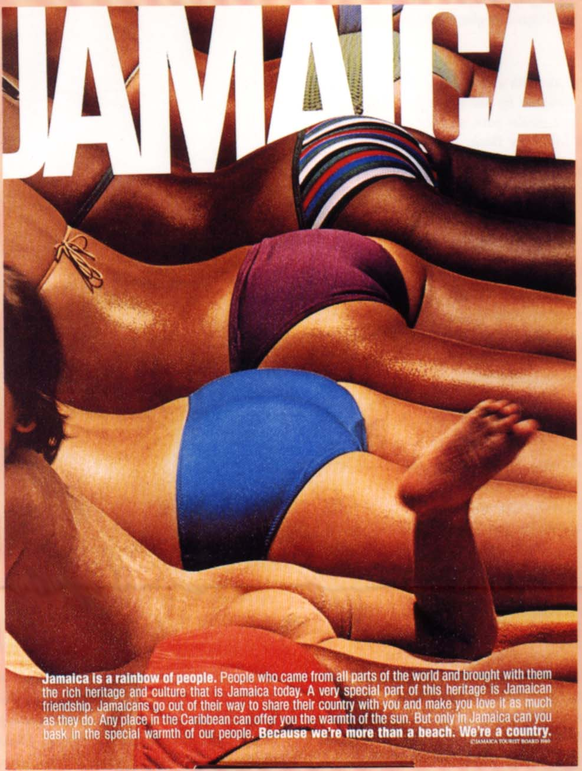
The DDB Style:
Jamaica - one word and a visual.

Slide 35
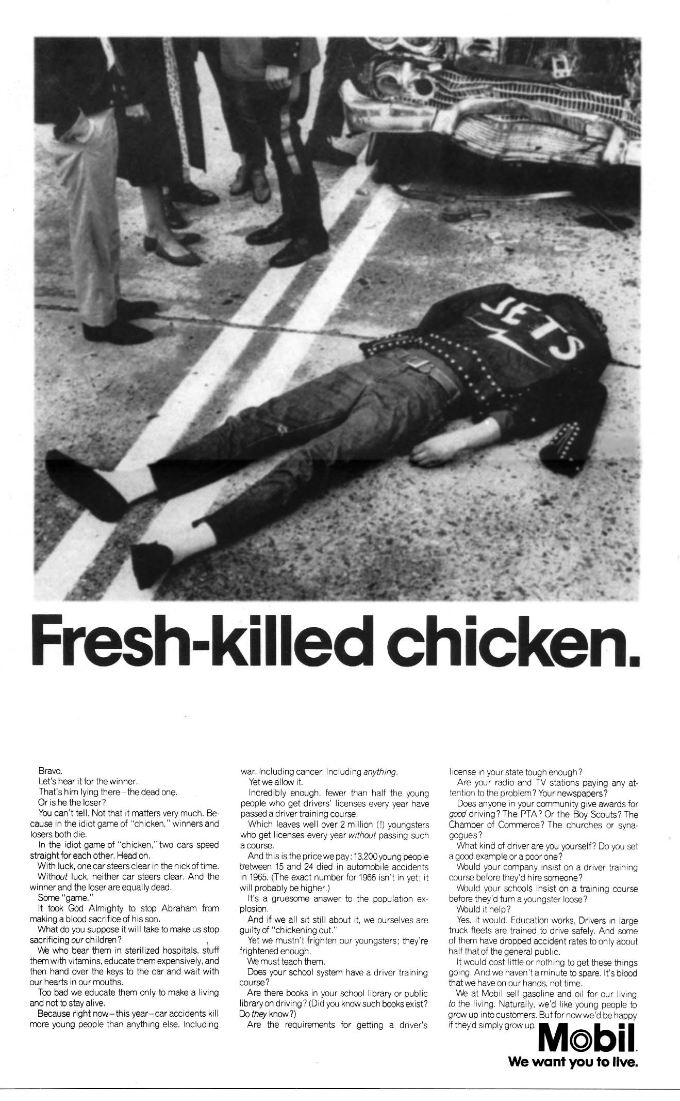
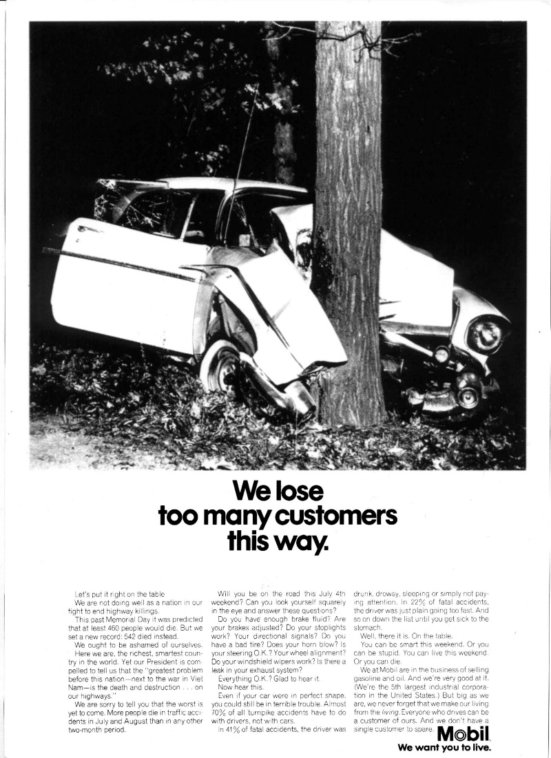
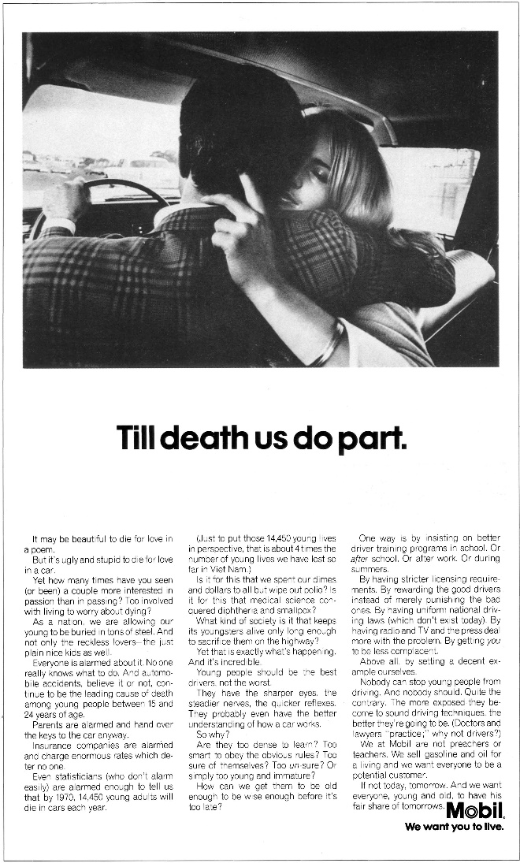
The DDB Style (cont):
3 Key Campaigns:
Mobil - “We Want You to Live”

